Slide 1
Vertical Scaling and Growth
Derek Briggs
EDUC 8720

Slide 2
Learning Objectives
To see the connection between vertical scaling and growth
To appreciate that it matters how the unit of a vertical scale is established.
To appreciate salient distinctions in vertical scale designs
Domain over which growth is defined
Way that common items are selected
To be able to understand how to interpret chained “linking constants” in the context of an IRT calibration approach.

Slide 3
Outline
Motivation: Practically Significant Differences?
Historical Background: Thurstone Scaling
Conventional IRT Methods
Activity: IRT Methods in Action

Slide 4
Motivating Context: Practically Significant Differences in Learning Outcomes

Slide 5
A Hypothetical Scenario
A randomized cluster trial is conducted to estimate the effect of exposure to Renaissance Learning’s Accelerated Math intervention.
California middle school students in grade 6 are the target population
The outcome of interest is the score on the end of year Smarter-Balanced (SBAC) summative assessment in math.
The main effect estimate (treatment – control) is 20 points on the SBAC score scale.
Notes:
http://www.smarterbalanced.org/assessments/development/percentiles/
Accelerated Math®, published by Renaissance Learning, is a software tool that provides practice problems for students in grades K–12 and provides teachers with reports to monitor student progress. Accelerated Math® creates individualized student assignments, scores the assignments, and generates reports on student progress. The software is typically used with the math curriculum being used
in the classroom to add practice for students and help teachers differentiate instruction through the program’s progress-monitoring data. This review focuses on studies of Accelerated Math®’s use in kindergarten through pre-algebra classes.

Slide 6
How should the effect of the Accelerated Math treatment be communicated?
How should the practical significance of the effect be evaluated?

Slide 7
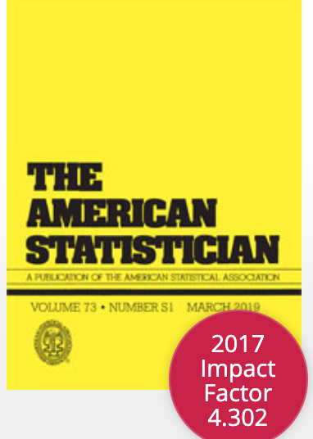
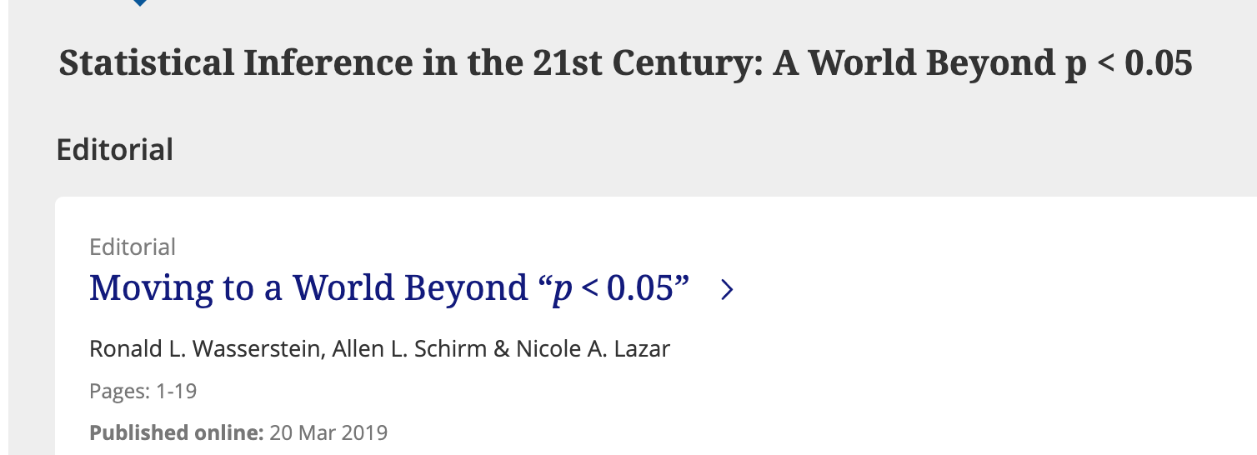
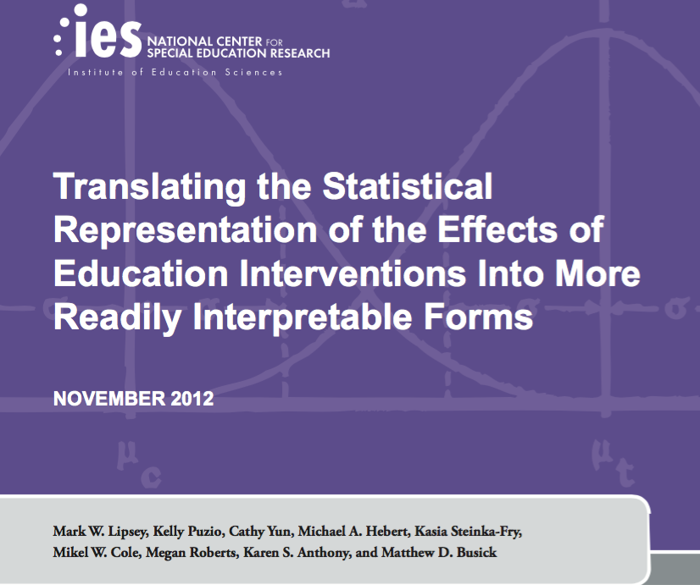
An answer that is not wrong per se, but insufficient
“The Accelerated Math intervention had a small but statistically significant (p < .05) effect size of 0.19.”

Slide 8
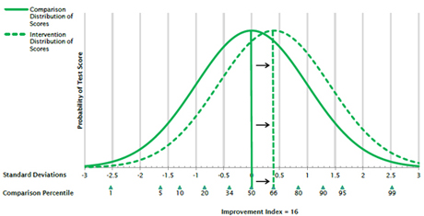
Lipsey et al (2012) on Representing Effects
as a standardized mean difference (effect size)
in terms of original metric
in relation to pre-post change
overlap in (normal) distributions
percentile differences (improvement index)
proportions above a cut
standard scores and normal curve equivalent
Example: WWC “Improvement Index”
https://ies.ed.gov/ncee/wwc/Glossary/improvement%20index

Slide 9
Conveying the Effect of Accelerated Math
Original metric: 20 points
Standardized mean difference (effect size): 20/105 = .19
Improvement Index = 7.5 percentiles
According to Cohen’s Conventions, an ES of .19 is considered a “small” effect.
The WWC benchmark for a “substantively” important effect is .25.
Does this mean the effect is not practically significant?
Treatment Z | Control Z | Percentile Increase
-1.8 | -2 | 1.2
-.8 | -1 | 5.0
.2 | 0 | 7.5
1.2 | 1 | 4.2
2.2 | 2 | .85
Notes:
prnorm(.19) = .575
According to Cohen’s Conventions, an ES of .19 is considered a “small” effect.
The WWC benchmark for a “substantively” important effect is .25, so this wouldn’t be considered practically significant.

Slide 10
Lipsey et al on Assessing Practical Significance
Using an external benchmark for
Normative expectations of academic growth
Policy-relevant performance gaps
Differences among schools
Observed effect sizes for similar interventions
Cost of the Intervention
Note that these are all norms that are usually external to the measured learning outcome.

Slide 11
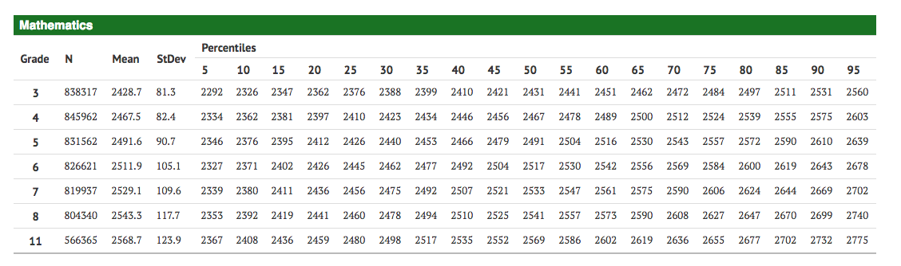
The SBAC Math Vertical Scale
The SBAC scale ranges from 2292 in grade 3 to 2775 in grade 12
In grade 6, scores range from 2327 to 2678, Mean = 2512, SD = 105
http://www.smarterbalanced.org/assessments/development/percentiles/

Slide 12
Growth on SBAC Math Tests

Slide 13
The Effect of Accelerated Math in Weeks of Learning
The Accelerated Learning ES is .19 SD units
This is ~ equivalent to an additional year of learning based on SBAC norms
There are 9 months in a school year, about 4.3 weeks per month, so = additional 39 weeks of learning
195 extra days of learning!
But had we used the Hill et al (2008) or more recnt Student (2024) benchmarks, the relevant numbers would be 4.5 months/19.4 weeks/96.8 days
Either way, it now appears we have a (very) practically significant effect.
 | Grade to Grade Gains in SD Units
Growth Norms | SBAC (2015-16) | Hill et al (2008) | Dadey & Briggs (2012) | Student (2024)
3 to 4 | .47 | .52 | .55 | .58
4 to 5 | .28 | .56 | .34 | .50
5 to 6 | .21 | .41 | .28 | .31
6 to 7 | .16 | .30 | .32 | .29
7 to 8 | .13 | .32 | .29 | .41

Slide 14
Historical Background:
Thurstone’s Method of Absolute Scaling

Slide 15
Looking for an analogy to units in the physical sciences
Gustav Fechner’s just noticeable differences unit (1860)
Alfred Binet’s mental age unit (1905)
Louis Thurstone’s standard deviation unit (1925)
Rasch’s logit unit (1960)

Slide 16
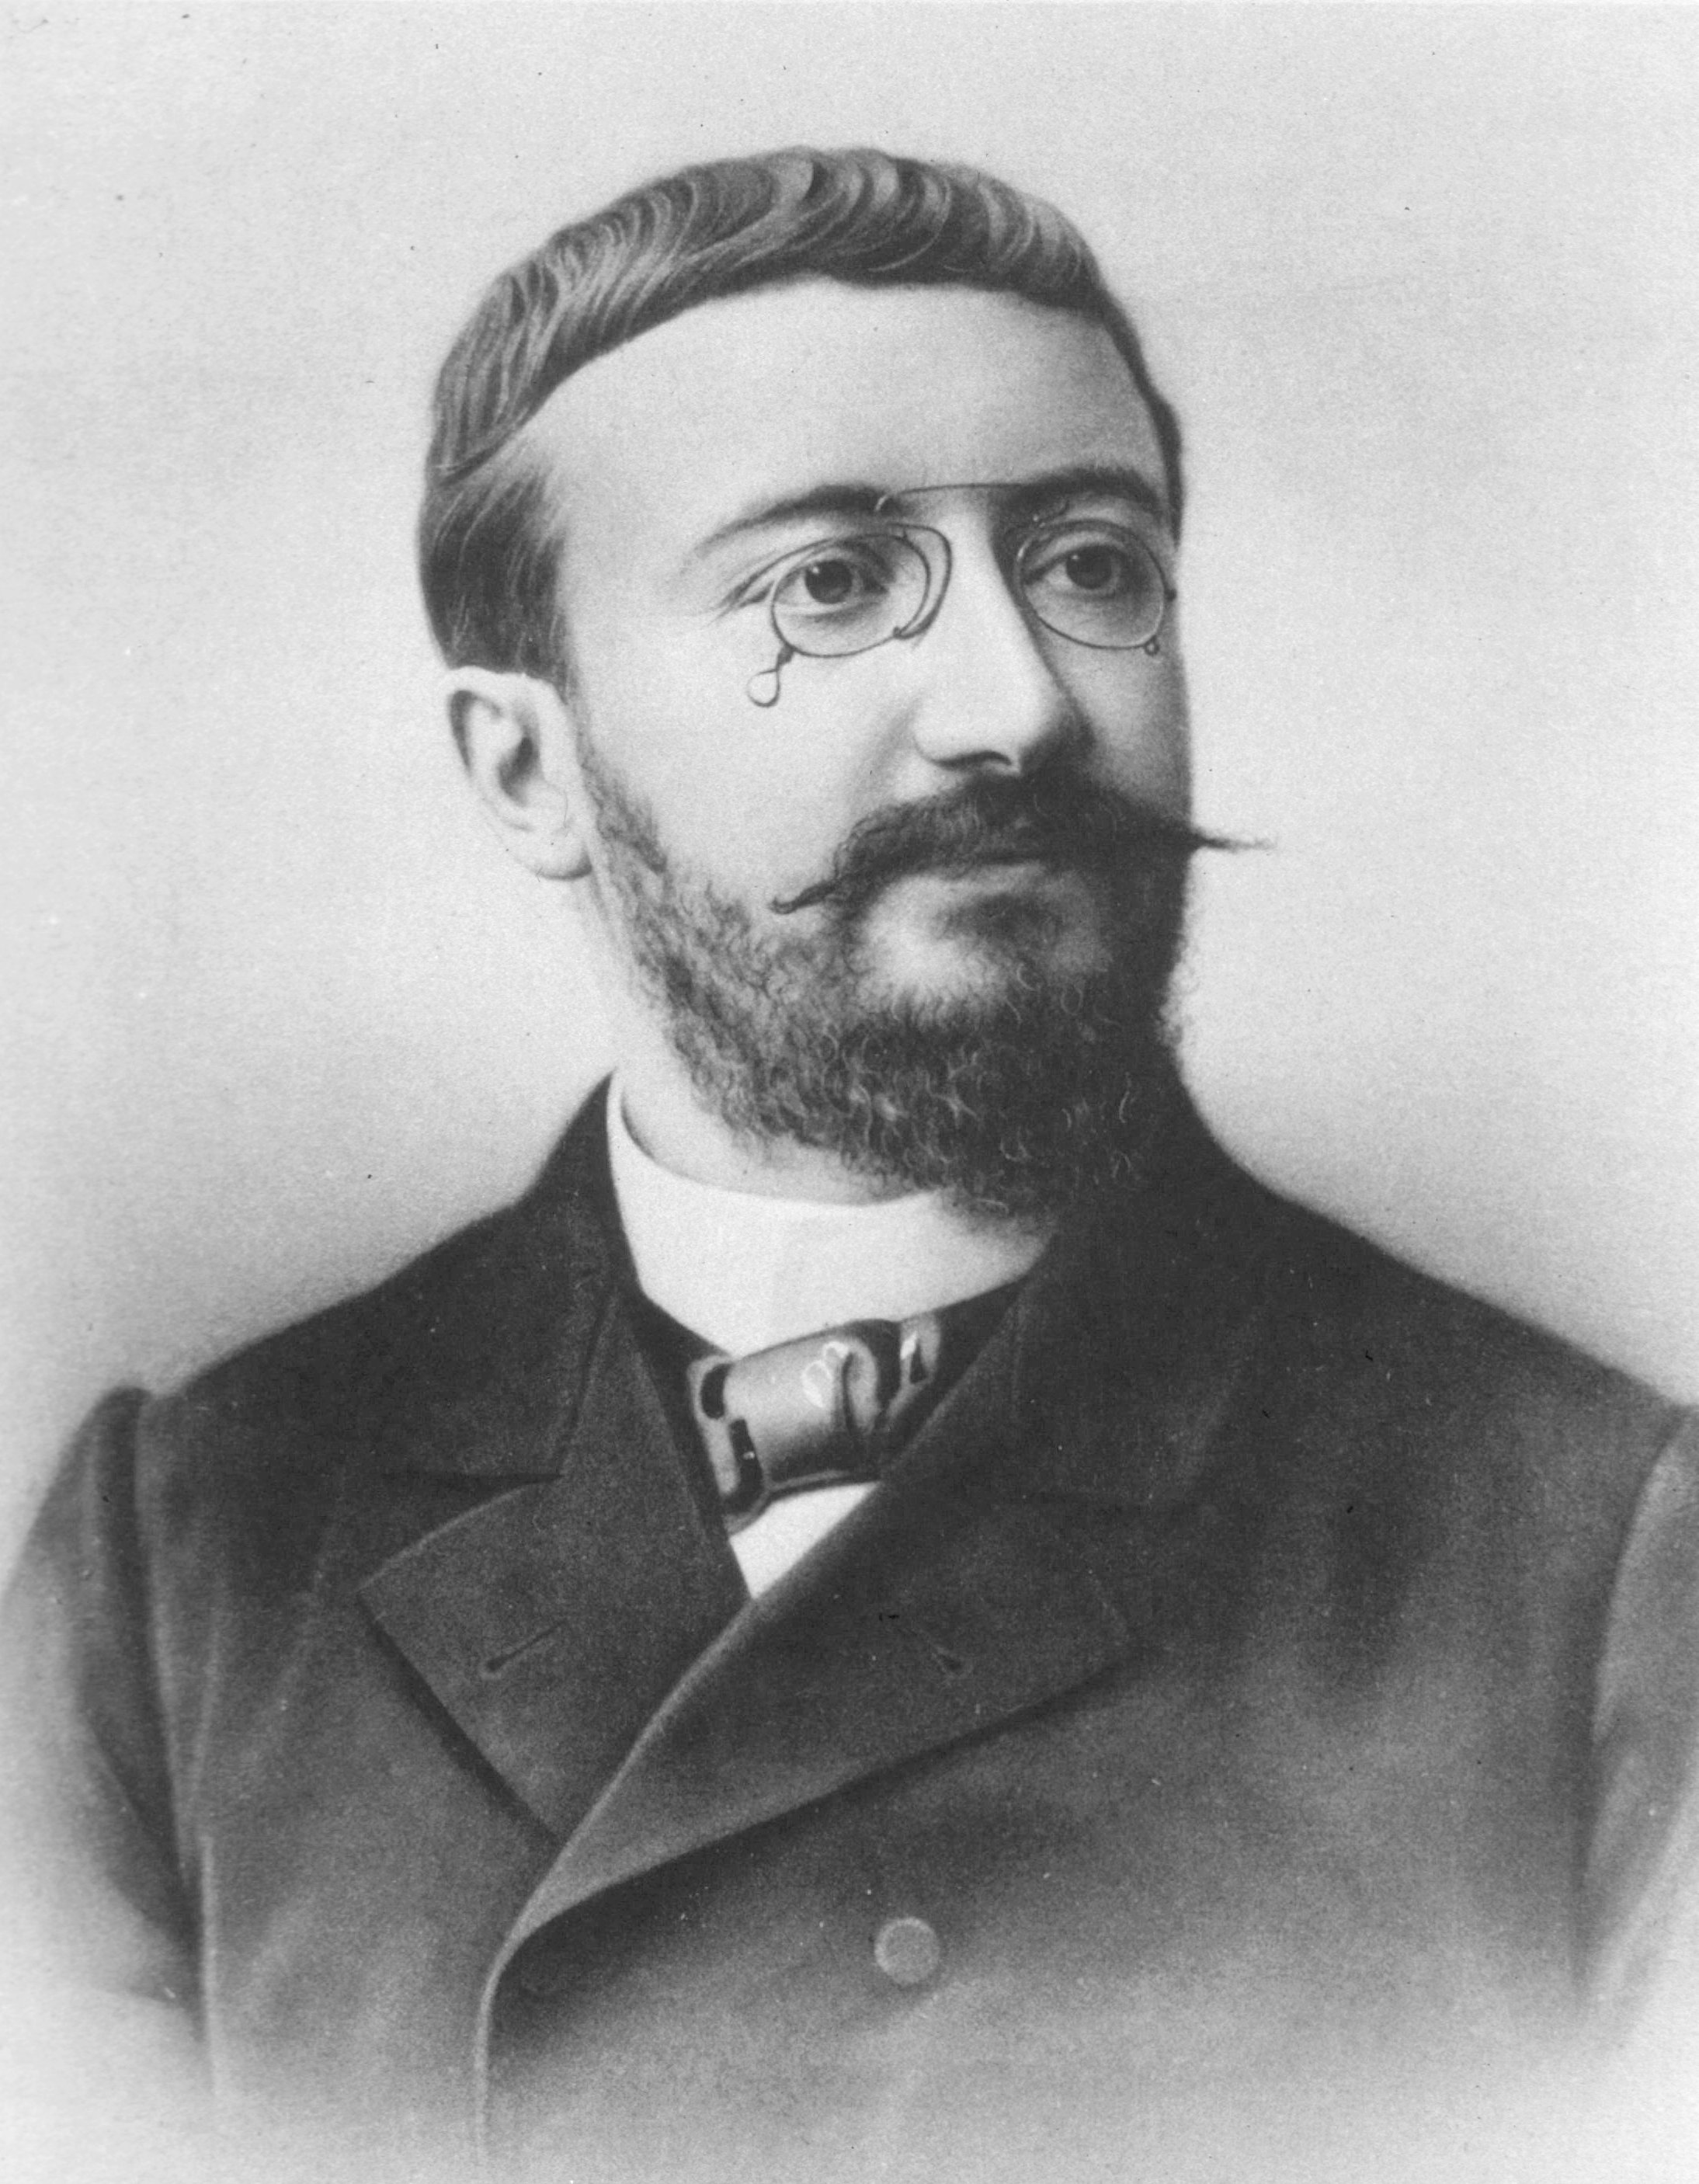
Alfred Binet (1857-1911)
Universal public education had only been established in France as of 1881.
Prior to this, children with (real or perceived) cognitive disabilities were sorted out of schooling.
In 1904, government appoints a commission to “investigate the state of the mentally subnormal in France.”
Binet is a member of commission, comes to appreciate need for a standard approach to decide which children require special services.
Conventional French labels for “subnormal” children at the time: Idiots, Imbeciles, Debiles (Americanized to “Morons” thanks to Henry Goddard)

Slide 17
Binet’s Methods
The goal was to establish a series of “tests” (really items) that could be ordered in difficulty.
Hierarchy based on age when 80-90% normally developing children could answer correctly.
Time-consuming process of trial and error.
Each series of tests involved one on one interviews with children.
For 1905 Scale, total population of “normals” was 50, “about 10 each” from pre-school, 5, 7, 9, 11 year old groups.

Slide 18
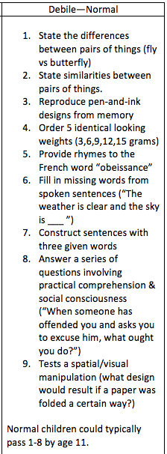
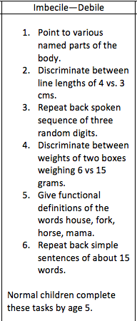
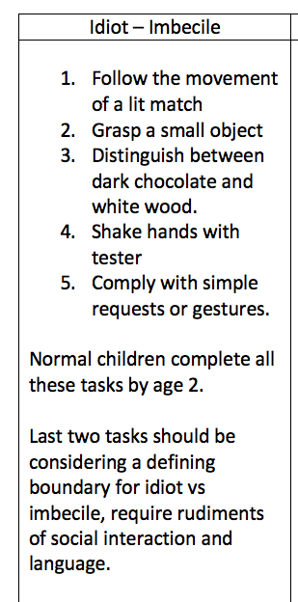
Binet and Simon’s 1905 Test

Slide 19
The 1908 Revision
New scaling approach to establish a “mental level”
Find age where child has passed all but one item associated with that age
Next give child a year of credit for every additional 5 items answered correctly (irrespective of difficulty of the item)
Increased norming sample to 300 students
Unique items per age level varied from 2 to 9.
In general, a child whose mental level was 2 years behind chronological age was one for whom special services were needed.

Slide 20
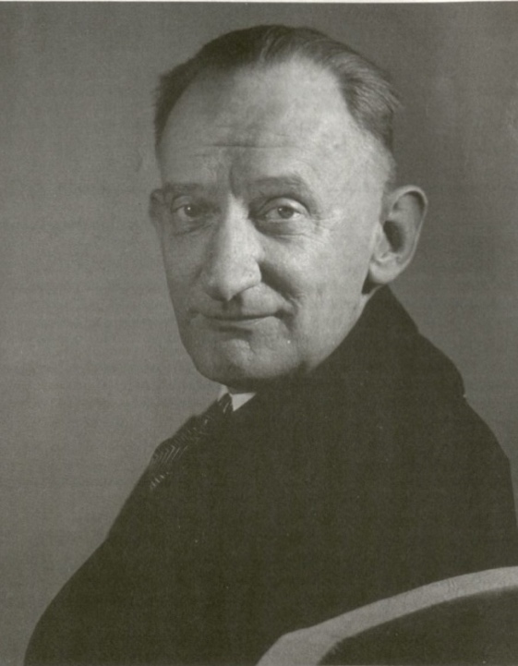
L. L. Thurstone (1887-1955)
(1925) A method of scaling psychological and educational tests. The Journal of Educational Psychology, 16(7), 433-451.
(1926) The mental age concept. Psychological Review, 33(4), 268-278.
(1927) The unit of measurement in educational scales. The Journal of Educational Psychology, 18(8), 505-523.
(1928) The absolute zero in intelligence measurement. Psychological Review, 35(3), 175-197.

Slide 21
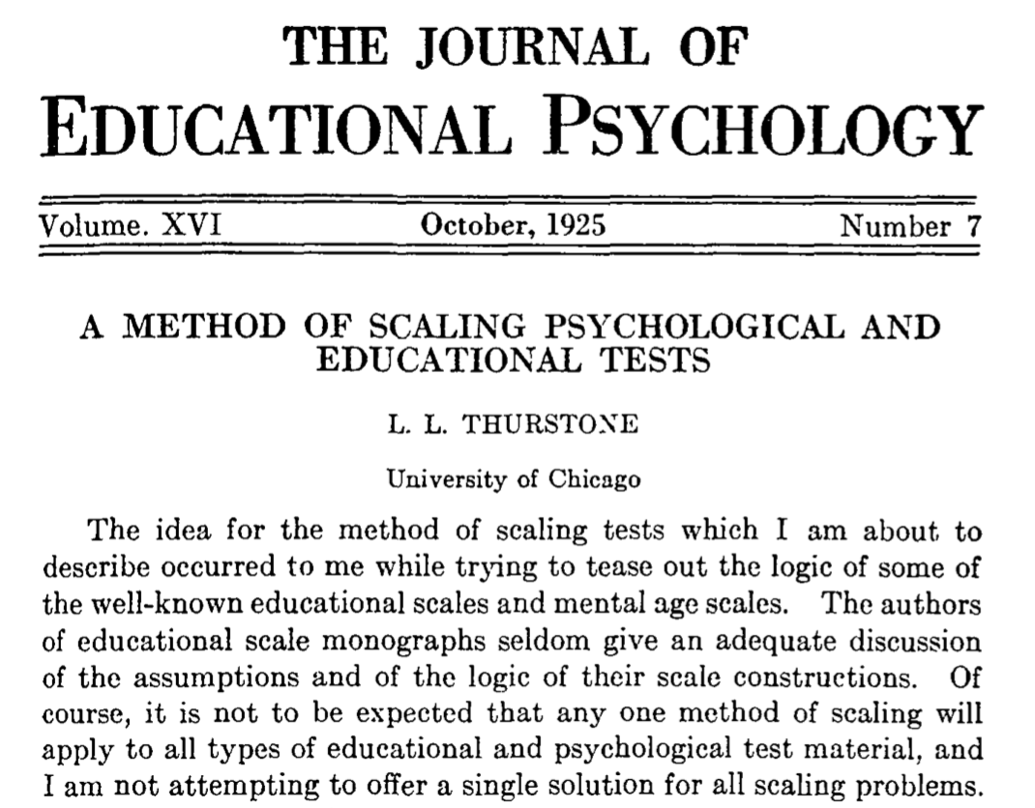

Slide 22
Problem with Age as a Unit of Measurement
The relationship between age and test performance is not symmetric (can’t be equated)
If we regress test score on age, we find the average score conditional on age. (Tell me child’s age, I tell you the predicted score)
If we regress age on test score, we find the average age conditional on score. (Tell me the score, I tell you the predicted age)
Choice is ambiguous, but will usually not give the same answer.
Thurstone, 1926

Slide 23
Thurstone’s Method of Absolute Scaling
Units of a raw test score have an equivocal meaning because items can (and do) differ in difficulty
Tests can always be constructed to ensure a normal distribution of raw scores, tells us nothing about the shape of the “true distribution”
Goal: The scale must be independent of the unit selected for the raw scores and from the shape of the distribution of raw scores (Thurstone, 1927, 519)
“ The whole study of intelligence measurement can hardly have two more fundamental difficulties than the lack of a unit of measurement and the lack of an origin from which to measure” (Thurstone, 1928, 176)

Slide 24
Requirements for Absolute Scaling
Applies when a test of ability is given to students at different ages
Tests have items that are scored as right or wrong.
Students in adjacent ages take overlapping/common items
Core Assumption: The underlying attribute being measured by each test can be conceptualized as a continuous quantitative variable with a normal distribution.
Notes:
Thurstone illustrated his approach with Binet items translated into English and administered to 3000 London school children by Burt.

Slide 25
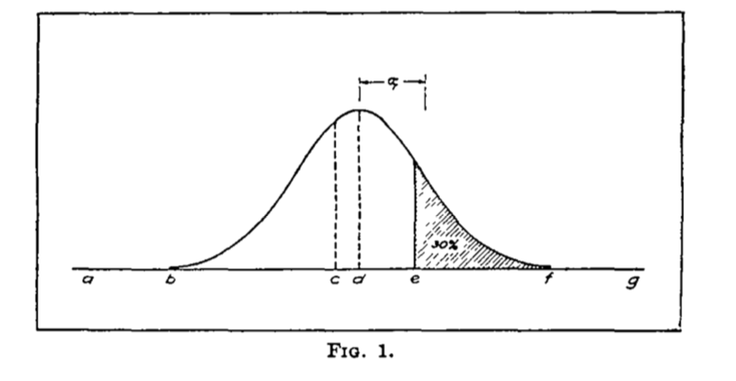
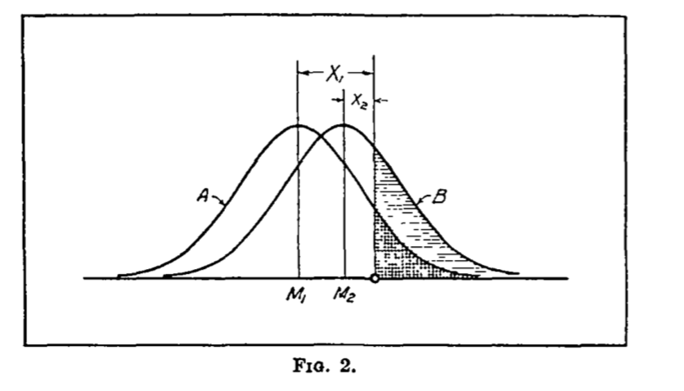
Finding a “Common Baseline”
Define the unit of measurement by the SD
For any two distributions of student ages, need to find the locations on a common scale, and need to establish a common unit of measurement
Older age group
Younger age group
The letters represent test items that range from very easy (a, b) to very hard (f, g) to answer correctly in an absolute sense.
A specific test question answered by both groups

Slide 26


Theoretical Transformation Constants
$M_{1}+X_{1}σ_{1}=$ $M_{2}+X_{2}σ_{2}$
where $X_{1}$ and $X_{2}$are “z scores” with respect to mean and SD of original age distribution (known),
$M_{1}$ and $M_{2}$ are the means of each age-specific distribution on the absolute scale (unknown)
$σ_{1}$ and $σ_{2}$ are the SDs of each age-specific distribution on the absolute scale (unknown)
$$X_{1}=X_{2}\left(\frac{σ_{2}}{σ_{1}}\right)+\left(\frac{M_{2}−M_{1}}{σ_{1}}\right)$$
slope
intercept
Notes:
This equation, if known, would transform the values of X2 common items (upper age scale) to be on the scale of X1 common item (lower age scale)

Slide 27
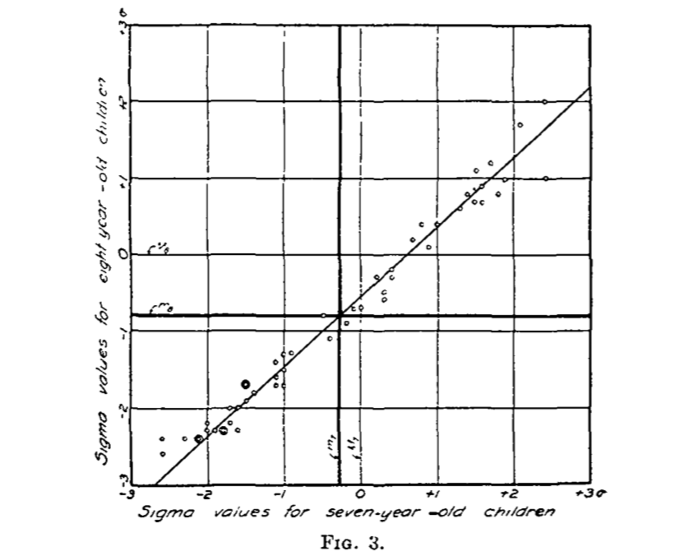
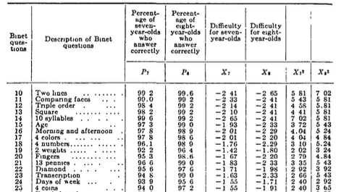
Empirical Strategy using Burt Data from Binet Tests
Use inverse of the normal curve to find z score associated with proportion correct for each common item by age
Plot the z scores? Are they close to perfectly correlated? If yes, go about estimating the equation for the line.

Slide 28
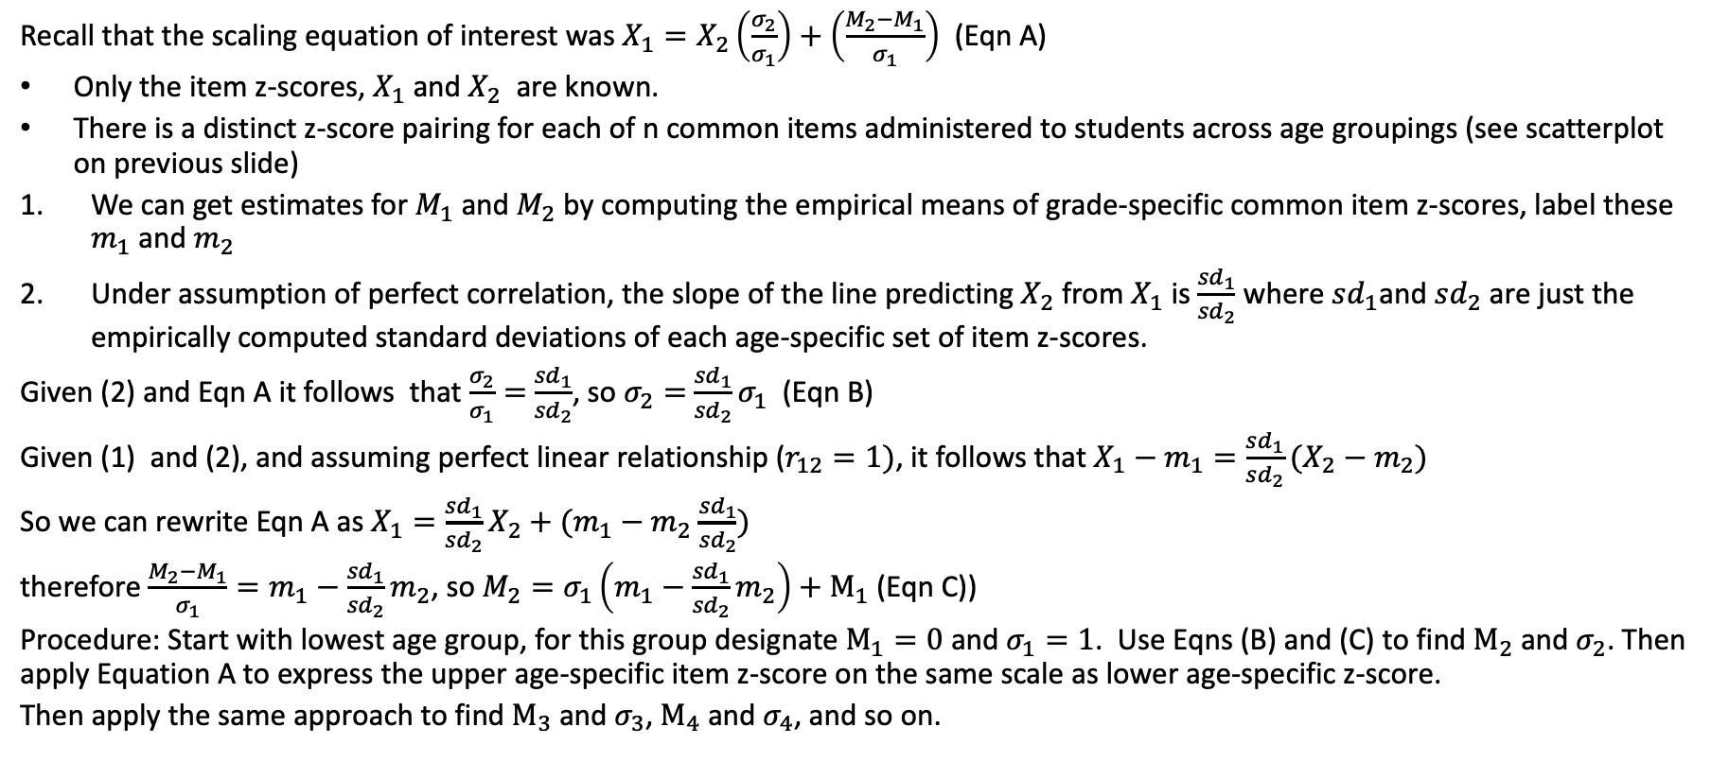
Technical Details of Thurstone’s Approach
Recall that the scaling equation of interest was $X_{1}=X_{2}\left(\frac{σ_{2}}{σ_{1}}\right)+\left(\frac{M_{2}−M_{1}}{σ_{1}}\right)$ (Eqn A)
Only the item z-scores, $X_{1}$ and $X_{2}$ are known.
There is a distinct z-score pairing for each of n common items administered to students across age groupings (see scatterplot on previous slide)
We can get estimates for $M_{1}$ and $M_{2}$ by computing the empirical means of grade-specific common item z-scores, label these $m_{1}$ and $m_{2}$
Under assumption of perfect correlation, the slope of the line predicting $X_{2}$ from $X_{1}$ is $\frac{{sd}_{1}}{{sd}_{2}}$ where $sd_{1}$and $sd_{2}$ are just the empirically computed standard deviations of each age-specific set of item z-scores.
Given (2) and Eqn A it follows that $\frac{σ_{2}}{σ_{1}}=$ $\frac{{sd}_{1}}{{sd}_{2}}$, so $σ_{2}=$ $\frac{{sd}_{1}}{{sd}_{2}}σ_{1}$ (Eqn B)
Given (1) and (2), and assuming perfect linear relationship ($r_{12}=1)$, it follows that $X_{1}−m_{1}=\frac{sd_{1}}{sd_{2}}(X_{2}−m_{2})$
So we can rewrite Eqn A as $X_{1}=\frac{{sd}_{1}}{{sd}_{2}}X_{2}+(m_{1}−m_{2}$ $\frac{{sd}_{1}}{{sd}_{2}})$
therefore $\frac{M_{2}−M_{1}}{σ_{1}}=m_{1}−\frac{{sd}_{1}}{{sd}_{2}}m_{2}$, so $M_{2}=σ_{1}\left(m_{1}−\frac{{sd}_{1}}{{sd}_{2}}m_{2}\right)+M_{1}$ (Eqn C))
Procedure: Start with lowest age group, for this group designate $M_{1}=0$ and $σ_{1}=1$. Use Eqns (B) and (C) to find $M_{2}$ and $σ_{2}$. Then apply Equation A to express the upper age-specific item z-score on the same scale as lower age-specific z-score.
Then apply the same approach to find $M_{3}$ and $σ_{3}$, $M_{4}$ and $σ_{4}$, and so on.
For further details see Thurstone (1925, pp. 438-440)

Slide 29
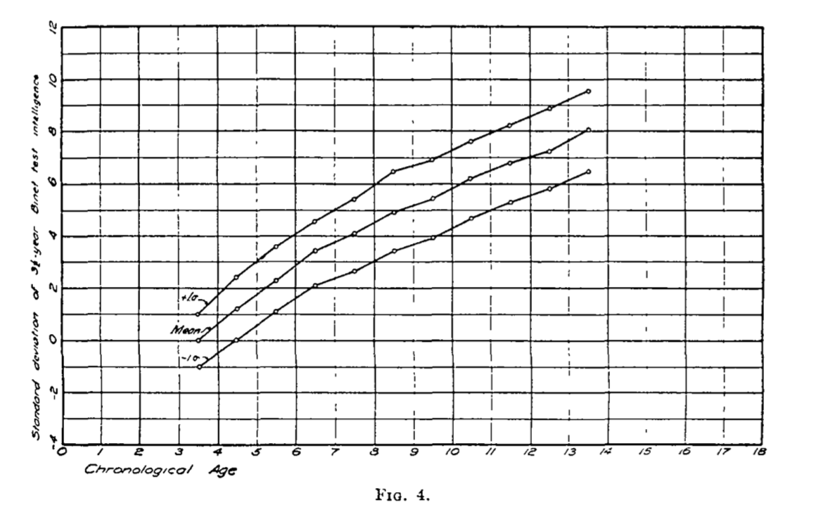
Result: Depiction of Growth on an Absolute Scale
Growth shows no sign of rapid deceleration
Variance increases over time (notice vertical distance from middle line as grade increases)
Missing evidence on growth in intelligence into adulthood
Thurstone: “Instead of acknowledging this limitation in our measurement methods, we have not infrequently attempted to juggle with the definition of intelligence to make it fit the measuring devices that are available.” (Thurstone, 1925)

Slide 30
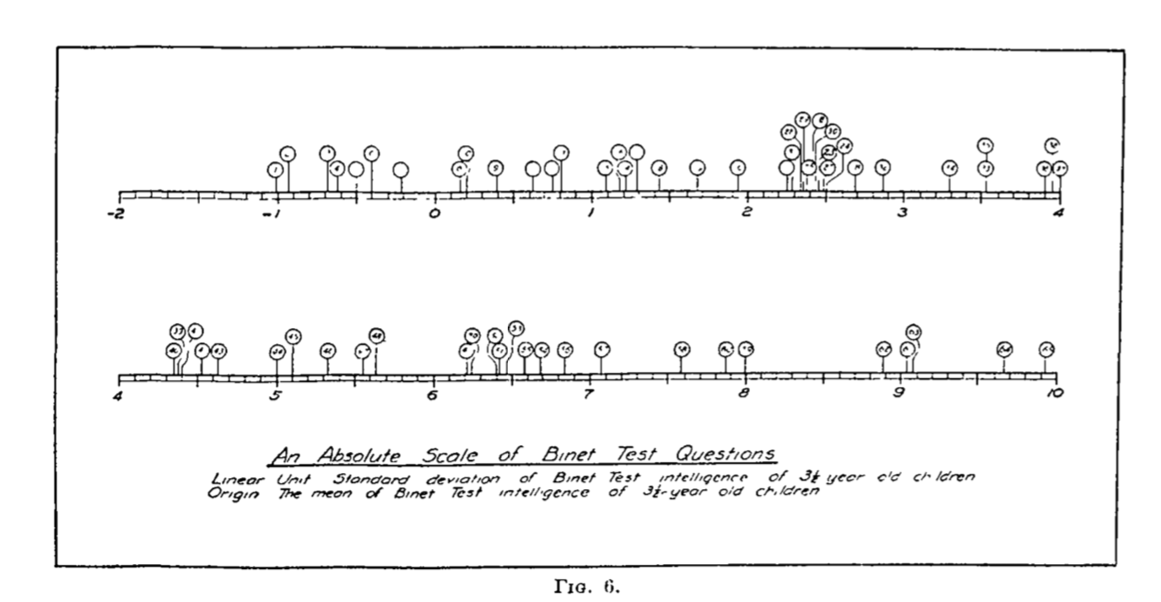
A “Map” of Binet Items on an Absolute Scale

Slide 31
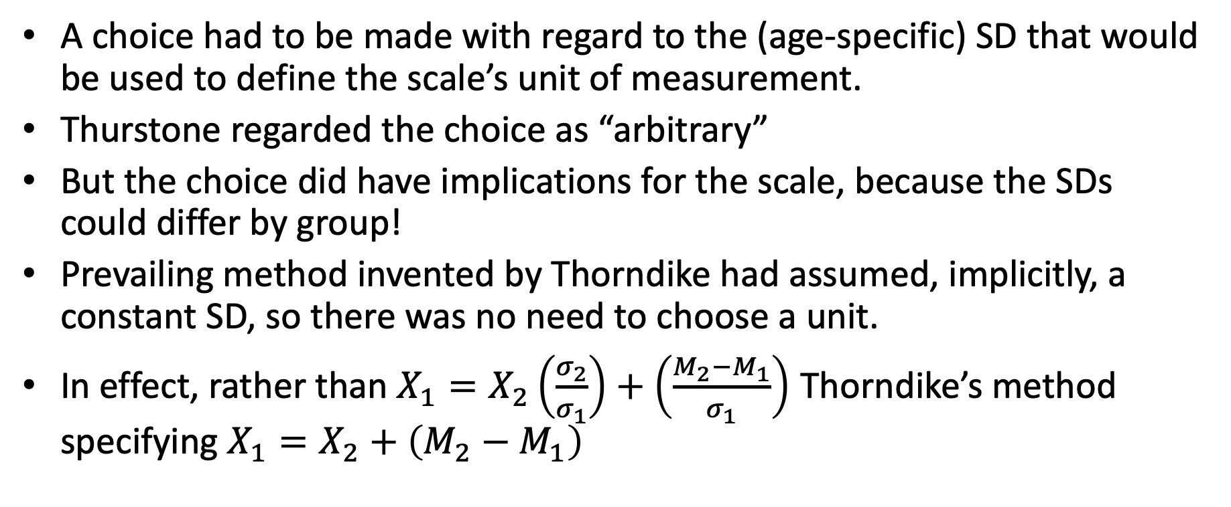
Thurstone’s Unit of Measurement
A choice had to be made with regard to the (age-specific) SD that would be used to define the scale’s unit of measurement.
Thurstone regarded the choice as “arbitrary”
But the choice did have implications for the scale, because the SDs could differ by group!
Prevailing method invented by Thorndike had assumed, implicitly, a constant SD, so there was no need to choose a unit.
In effect, rather than $X_{1}=X_{2}\left(\frac{σ_{2}}{σ_{1}}\right)+\left(\frac{M_{2}−M_{1}}{σ_{1}}\right)$ Thorndike’s method specifying $X_{1}=X_{2}+\left(M_{2}−M_{1}\right)$

Slide 32
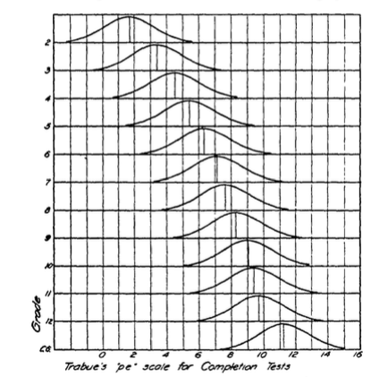
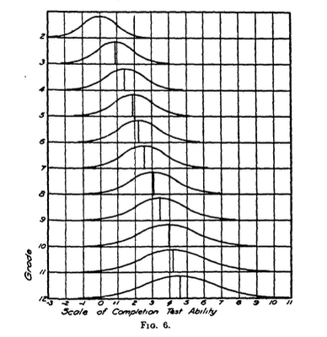
Example: Trabue’s Test of Sentence Completion
Trabue’s assumption of homogenous SD unit
Scaled with grade 2 as SD unit
Thurstone, 1927

Slide 33
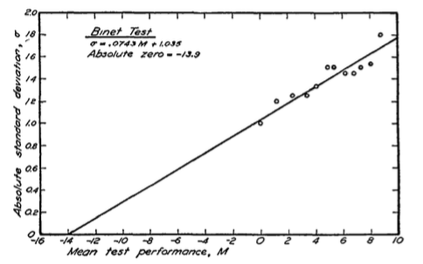
Finding an Absolute Zero
Applied absolute scaling approach to 7 different intelligence tests
Administered to students in different age groups
Clear pattern emerges: variance is an increasing linear function of age.
Plot absolute scale SD against mean test performance by age
The absolute zero is the point on scale where extrapolated SD = 0.
Thurstone, 1928

Slide 34
Summary of Thurstone Scaling Steps
Thurstone (1925) based on items
Thurstone (1938) based on persons
For each of K common items between two tests, find proportion correct in lower and upper grade/age.
Use inverse of normal cdf to find z scores.
Plot them, find correlation. If there is strong linear association, proceed. Otherwise, stop.
Use mean and sd of z scores across items to estimate linking constants
Repeat for next pair of grades.
Choose 10-20 total scores at different percentiles of common item distribution for lower and upper grade/age.
Normalize the two frequency distributions. (based on assumption that underlying distribution is truly normal, and we may see some slight deviations based on sample of test-takers)
Now follow steps 3-5 of 1925 approach.

Slide 35
Conventional IRT Methods of Creating a Vertical Scale

Slide 36
Creating a Vertical Scale: Conventional Wisdom
Design Stage
How will growth be defined?
Placement of common items
Calibration/Estimation Stage
Choose an IRT Model
Separate vs Anchored or Concurrent Calibration
Set the Scale (linear transformation of theta)

Slide 37
Growth Definitions
Kolen & Brennan (2004)
“Domain” Definition
Growth over all the standards to which a test has been written across grades
“Grade to Grade” Definition of Growth
Growth over standards that overlap across grades
Briggs & Peck (2015)
“Learning Progression” Definition of Growth
Growth over well-defined big picture concept over multiple grades (but probably not all!)

Slide 38
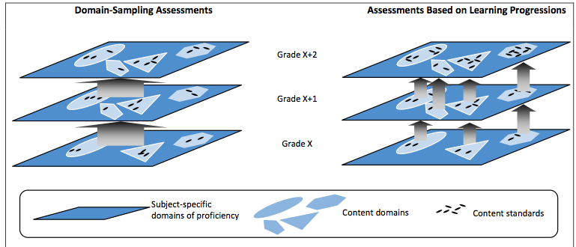
Different Growth Definitions

Slide 39
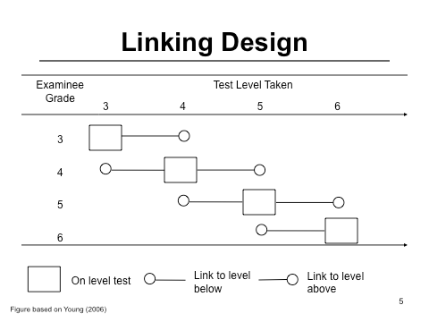
Common Item Linking Designs
A “down” link
An “up” link

Slide 40
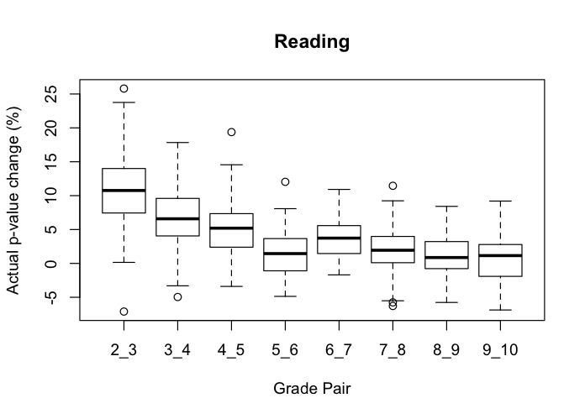
Observed P-Value Changes in One State’s Field Test
Briggs & Dadey, 2015

Slide 41
“Up” Links vs “Down” Links
Up Link Common Items: How would a 4th grade student do on 5th grade test?
X O X Design [Pretest Instruction Postest]
Down Link Common Items: How would a 5th grade student do on 4th grade test?
O1 X O2 X Design [Instruction Posttest x2]
Which design is better? How does this interact with growth definition?

Slide 42
Why Use IRT to Link Tests with a Common Item Design?
Leveraging the property of parameter invariance .
If the model fits the data, then Item parameter estimates should be the same regardless of the group used to estimate them.
So the idea is this—any difference observed in parameters for common items must be an artifact of the way the scale was anchored.
The item parameters should be linearly related.
So we establish the link between tests on basis of common items and then extrapolate.

Slide 43
Choice of IRT Model
Rasch/PCM vs. 2PL/GRM vs. 3PL/GRM
This is often not treated as a decision point for a vertical scale design.
But has real implications if an argument is being made for interval properties.
Idealized scale properties of Rasch Model >> 2PL, 3PL
See Briggs (2013) for more

Slide 44
Linking Separate Calibrations
A linear transformation is used to place the parameters from one test—the “From” scale—onto the scale of the other—the “To” scale.
Ability Estimates
Item Parameters
“A” and “B” are the linking constants

Slide 45
Chain Linking
To create a vertical scale for multiple tests using a separate approach, chain linking is used to place the tests on a base grade
Linking constants are computed for each pair of adjacent tests and then parameters are transformed in sequence.
Grade 3
Grade 4 (base gr)
Grade 5
Grade 6
C43
C54
C65

Slide 46
Concurrent Calibration
The item parameters from different populations of students are estimated simultaneously
20 10
Example:
20 Unique Grade 3 Items
20 Unique Grade 4 Items
10 Common Items
50 Total Unique Items
Grade 3
10 20
Grade 4

Slide 47
Set the Scale: Transform Theta
The scaling constants: SBAC Scale Score = (79.3)θ + 2514.9
→ each change in a logit is equal to about 80 scale score points (why 80? No idea, and that’s part of the problem with conventional methods)

Slide 48
Activity
I have uploaded the 2018-19 technical manual for the state of Arizona’s large-scale assessment given to students in grades 3-11, called AzMERIT.
Please read the short section that describes the approach that the state’s test vendor, AIR, took to create a vertical scale for the math and reading tests on pages 153-157.
Note: the state uses the Rasch Model and PCM for test items, see pp. 150-153 for those details.
Questions for you to discuss in small groups:
What was AIR’s common item design? How are they defining growth?
How did they choose a “final linking set” of common items? How does the approach differ in math vs reading?
They present a comparison of separate vs concurrent calibration. Which approach do they recommend and why?
Why are they only reporting a single linking constant (as opposed to two) by test subject and linking approach in the tables on page 155?

Slide 49
Other Issues in Vertical Scaling
Impact of Methods on Growth Inferences (Briggs & Weeks, 2009; Briggs & Domingue, 2013)
Comparing Thurstone scaling to IRT scaling (Tong & Kolen, 2007; Williams, Pomerich & Thissen, 1998)
Scale Properties (Interval vs. Ordinal) (Ballou, 2009; Briggs, 2013; Domingue, 2013)
Non-linear transformations of theta (Briggs & Domingue, 2013)
Scale shrinkage & deceleration (Dadey & Briggs, 2012; Bolt, Deng & Lee, 2014; Student, 2022; 2024)
Maintaining a vertical scale (the problem of item drift) (?)
Selecting common items (Briggs & Dadey, 2015; Student, Briggs & Davis, 2024)
Conceptualizing and Quantifying linking error (?)

